Slide 1
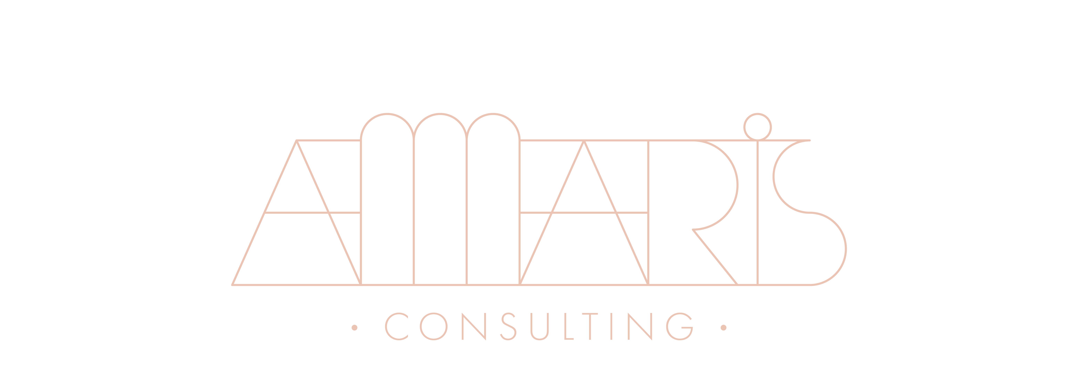

09/05/2023

Slide 2
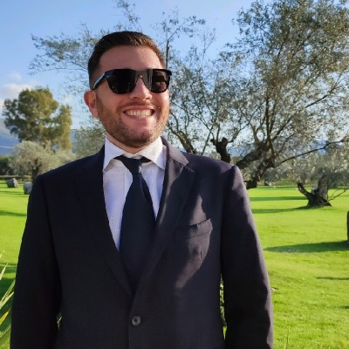
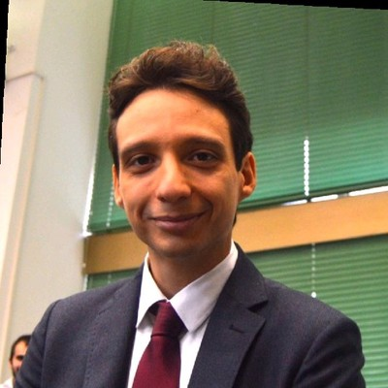
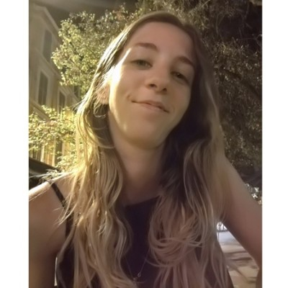
Welcome!
Marco Pugliese
Giacomo Matzeu
Alessia Magnani
Senior Manager
Engineering Division
mpugliese@amaris.com
Experienced Consultant
Engineering Division
gmatzeu@amaris.com
Experienced Consultant
Engineering Division
amagnani@amaris.com

Slide 3
Summary
1
Company Overview
2
Our solutions
3
Be a consultant in Amaris
4
Q&A

Slide 4
01 Who we are

Slide 5





Who we are?
3
Amaris Consulting is an independent consulting firm providing guidance and solutions to businesses.
7,000
Talented People
We are a community of entrepreneurs and craftspeople, passionate about achieving excellence.
We earn the trust of our clients because their
success is our business.
1,000
Clients worldwide
60+
Countries presence

Slide 6



Growth and Internationality
5
2007
First Office in Geneva
2019
Mantu’s Birth
2011
Multinational Company
Mantu means “Adviser” in Sanskrit. It is an international consulting platform
providing guidance and services to businesses and entrepreneurs.

Slide 7


What’s the relationship between Mantu and Amaris?
Mantu is an international consulting platform providing guidance and services to businesses and entrepreneurs.
Mantu is made of an ecosystem of different brands (see next slide)
Amaris Consulting is a Brand of Mantu ecosystem, part of the technology practice.
Regardless of their expertise or the sector they operate in, all the brands share a single mission: build and nurture a talent community to achieve businesses and entrepreneurs’ ambitions.

Slide 8










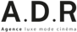

Mantu’s brands
International consulting services
Digital strategy and design
Purpose and impact consulting
Connecting today’s expertise and tomorrow’s talent
Workforce and HR solutions
Portage services
Research and development
Delivering digital transformation
HR systems and consulting
Sustainable marketing procurement
Immersive experiences
Events and experiences
Financial Service
Communication agency
Optimizing organizations and HR

Slide 9

Our global presence
With more than 7000 people from 95 different nationalities, spread across 5 continents and more than 60 countries, we help our clients go global and support them wherever they need us.
A global presence operating 24/7
Local branches in more than 60 countries with 80+ offices
Our global offices: Providing the proximity & the capacity to follow your projects almost everywhere in the world.

Slide 10
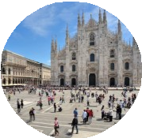


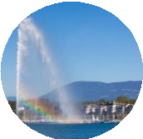

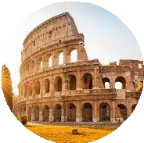
Where we are in Italy
8
We have offices in Roma, Genova, Bologna, Torino, Milano, and Bari. We are more than 300 people working together on national and international projects.
300 People
10 Different Languages
100 Clients Worldwide

Slide 11
02 Our Solutions

Slide 12
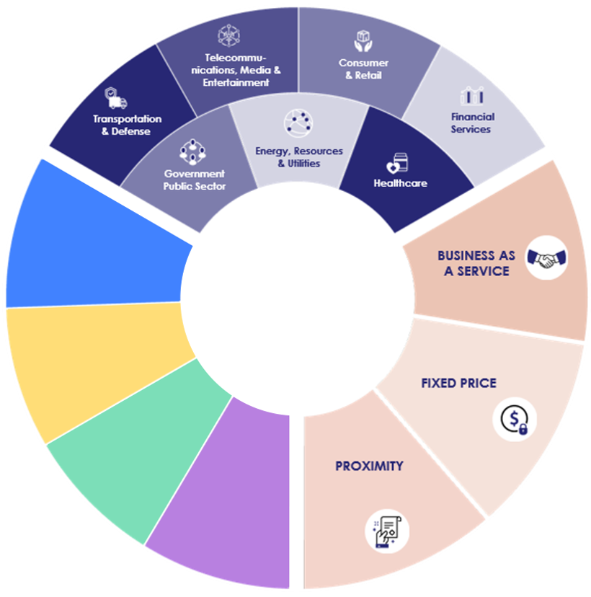



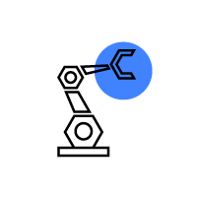








A client centric
brand & approach
OFFERINGS
IS & DIGITAL
SOLUTIONS
IS & DIGITAL
Market Sectors
IS & Digital
Business Lines
TIME & MATERIAL
Service Model
Telecom
CLIENT
OFFERINGS
TELECOM
SOLUTIONS
TELECOM
TURNKEY PROJECT
Life Sciences
SOLUTIONS
LIFE SCIENCES
HYBRID
MODE
OFFERINGS
LIFE SCIENCES
Engineering
SOLUTIONS
ENGINEERING
OFFERINGS
ENGINEERING

Slide 13


Engineering Solutions
At Amaris, we are dedicated to helping clients with their toughest engineering challenges. Be it System Engineering, R&D, Sustainable Engineering, or Smart Manufacturing, our experts help them in assessing and updating their strategy to reflect today's shifting markets.
System Engineering
Smart Manufacturing & Factories
Research, Development & Design
Project Management & Quality
Sustainable Engineering
Operations & Manufacturing

Slide 14

Engineering Solutions
11
Concept of Operations
Acceptance Test
System
Functional
System Requirements
System Test
Subsystem
Subsystem
Subsystem Test
Requirements
Subsystem Design
Unit
Integration Test
Unit Design
Unit Test
Technical
Code
CONFIDENTIAL

Slide 15

Life Sciences Solutions
We offer a wide spectrum of services to Pharmaceutical, Medical Device, and Biotechnology companies. Our understanding of market dynamics, customer demands, and regulations means that we can assist clients at every stage of the product lifecycle and help develop and embrace innovative processes and technologies.
Health Economics, Outcomes Research (HEOR) and Market Access
Manufacturing excellence
Innovation
Engineering and R&D
Quality & Regulatory

Slide 16
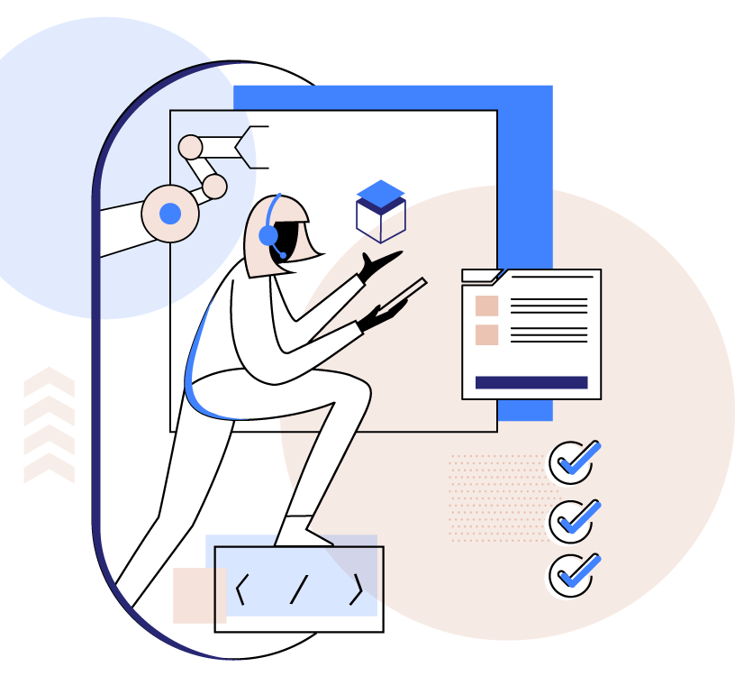
IS & Digital Solutions
In the era of globalization and rising competition, our holistic Information System & Digital (IS&D) services help tip the odds in client’s favor. With a presence in over 60 countries, we have the resources and expertise to react 24x7 to their needs and create standards of excellence by providing assistance both on-site and remotely.
Strategy and Management
Design and Development
Data Innovation
Digital Workplace
Business Applications & Processes
Platform and Security

Slide 17



03 Being a Consultant in Amaris

Slide 18



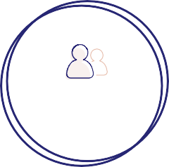


Our Values
In Amaris Consulting
17
Being a Consultant at Amaris means being part of a community that shares a strong bond among its members. That connection can be shown in four values that create the basis of our DNA that all Consultants have.
PERFORMANCE
PIONEER SPIRIT
CARE
INDEPENDENCE
TRUST

Slide 19





Empowerment
Meritocracy
Job mobility & diversity
Startup mindset
Why Amaris Consulting
18
Interesting projects with top clients
Intrapreneurship
Flexibility
Independence
International teams
Hubs & offices all
around the world
International environment
Dynamic environment
Digital environment
Agility
International mobility
Remote & Digital work
Hybrid work model (remote working and in-office)
Supportive Leadership
“In step with you”
Personalized management
Expertise
Feedback culture
Trust
Tailor-made learning paths

Slide 20
Career Path
19
In Amaris Consulting

Slide 21
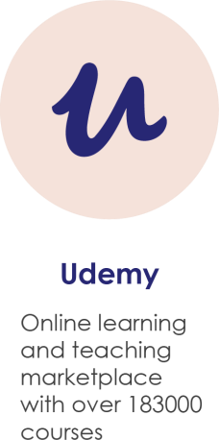






Life in Amaris Consulting
20
Afterworks
Afterworks with the teams or in smaller groups
Team buildings
Quarterly team buildings for fun activities together
Weshare
A corporate social network, where you will gather your interests with every talent from the group.
MAAP
One time per year to review the entire performance and set new goals
Project Review
Each 3 months, meeting with Manager and Client to review the Project
Manager Relationship
Close relationship and Career Coaching
Additional Roles
Trainer, Offer Manager, Technical Partner…

Slide 22
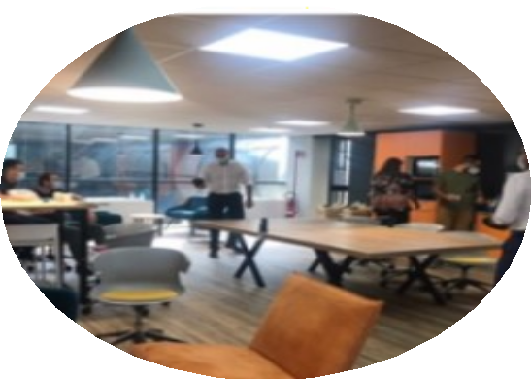
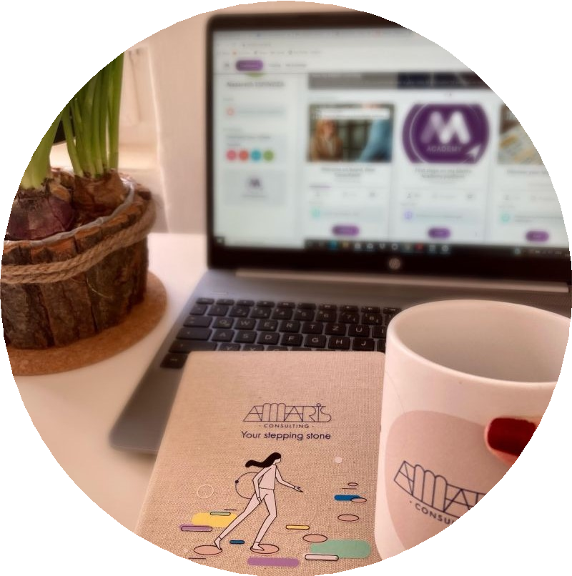
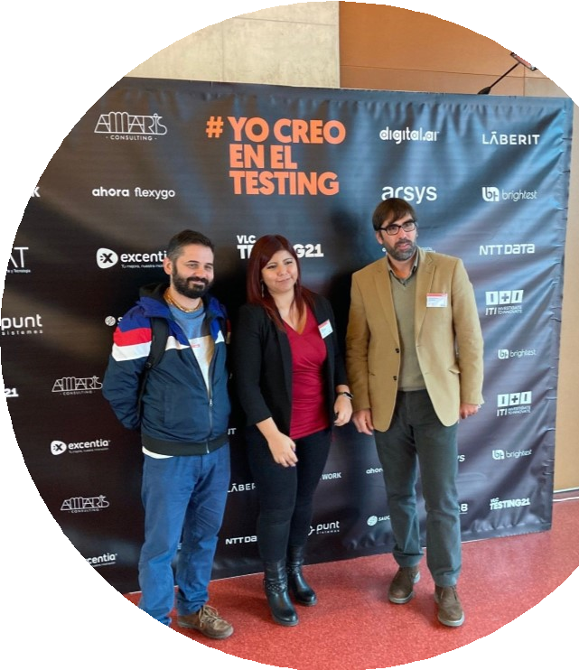
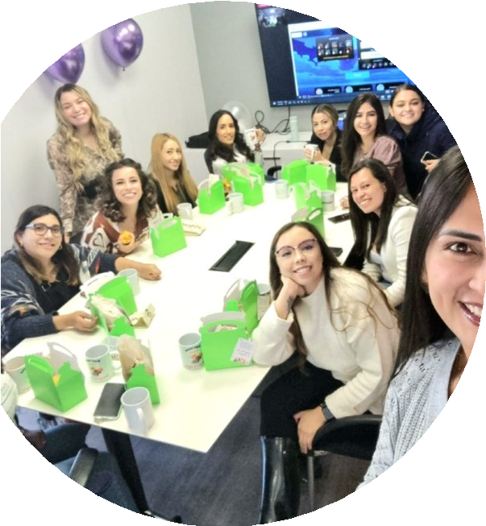
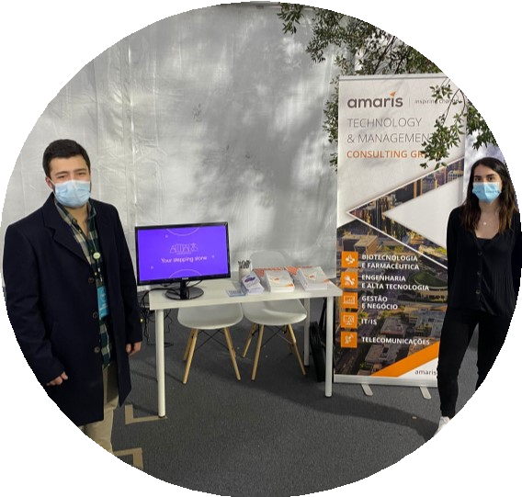
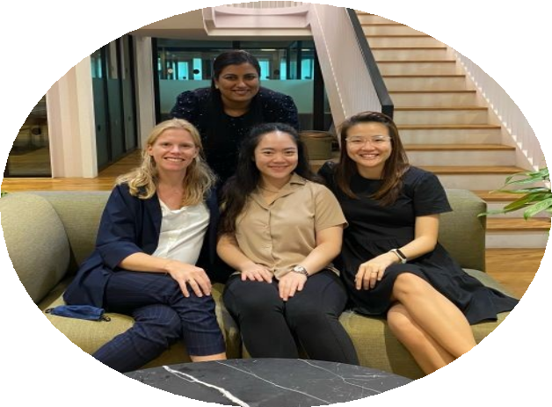
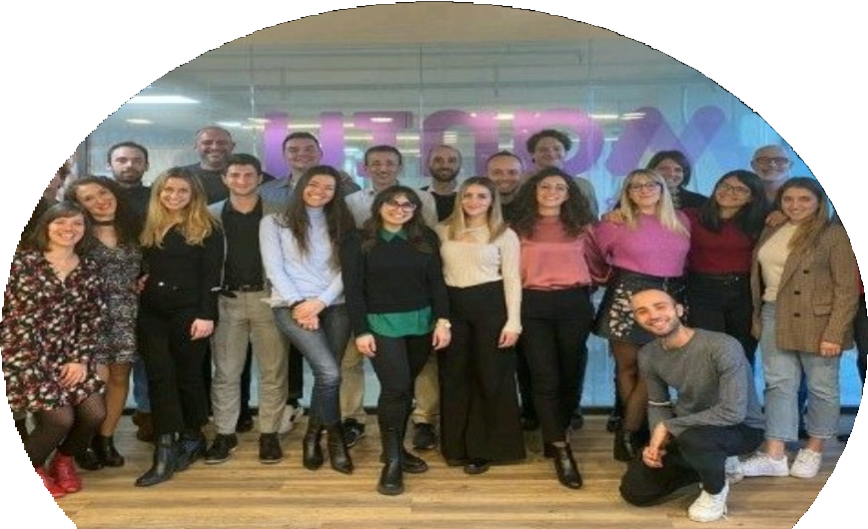
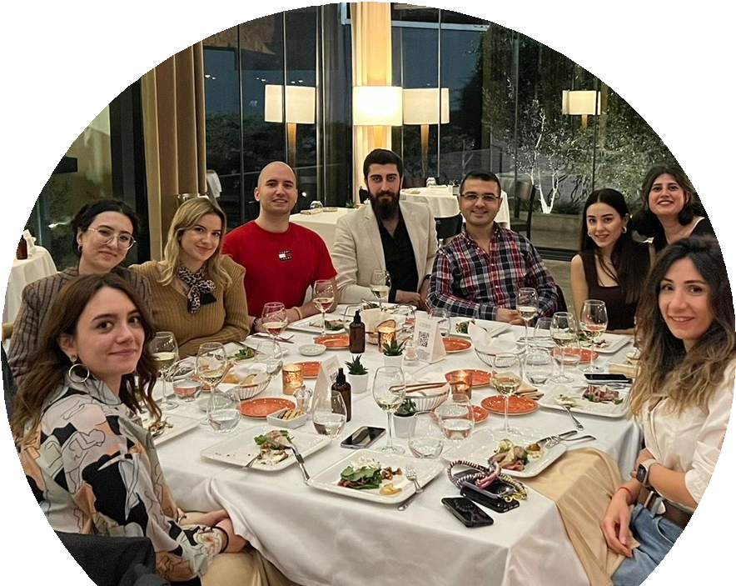
Life in Amaris
Amaris Consulting Italia
21

Slide 23
Grazie dell’attenzione!
Q&A Session

Slide 24



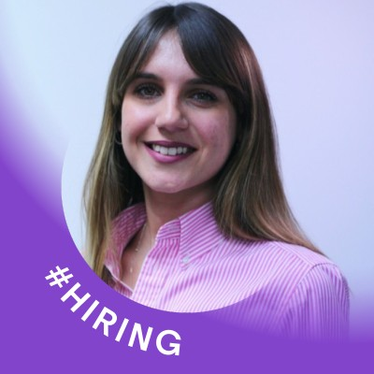
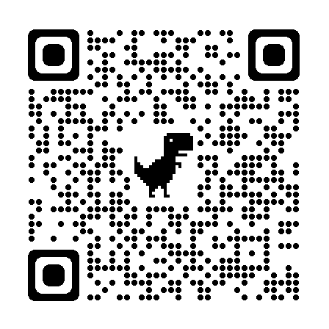
Our Recruitment Contact
Petra DI BERNARDINI
Senior Talent Acquisition Specialist
pdibernardini@amaris.com
Scan this QR and apply in our job offer!
Amaris Consulting
www.careers.amaris.com

